Slide 1
# 数据科学入门2.1：机器学习介绍，以及更多回归
## Introduction to Data Science Part1.1: Intro
Zheng Wei

Slide 2
Goals
More in-depth stuff of machine learning
Train-validation-test split
Classification
Clustering
Neural networks
Finally a glance of the tensorflow2 (python of course)

Slide 3
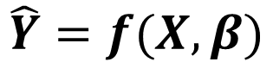
The routine of data science
$$\hat{Y}=f(X,β)$$

Slide 4
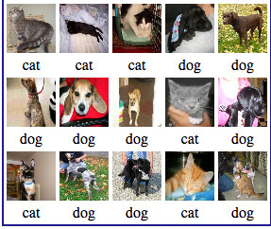
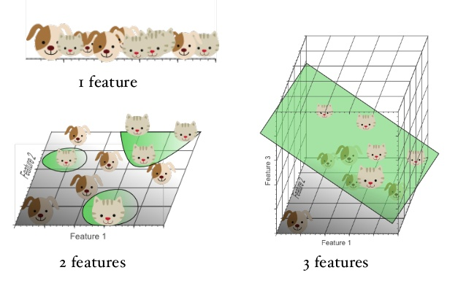
Types of Machine Learning
Features
X
Label
Ground-Truth
Y
Supervised learning
Trained with labeled data
Regression
Classification
Unsupervised learning
Trained with unlabeled data
Clustering
Anomaly detection
Supervised learning: with lable
Unsupervised learning：no label

Slide 5
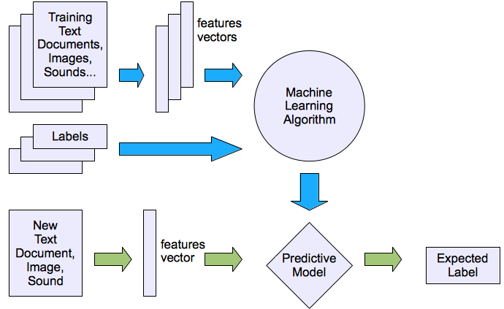
Supervised learning
TrainedModel=Model.Train(X,Y)
TrainedModel=Model.Fit(X,Y)
fitlm([exp4.x1 exp4.x2 isSmoker],exp4.y)

Slide 6
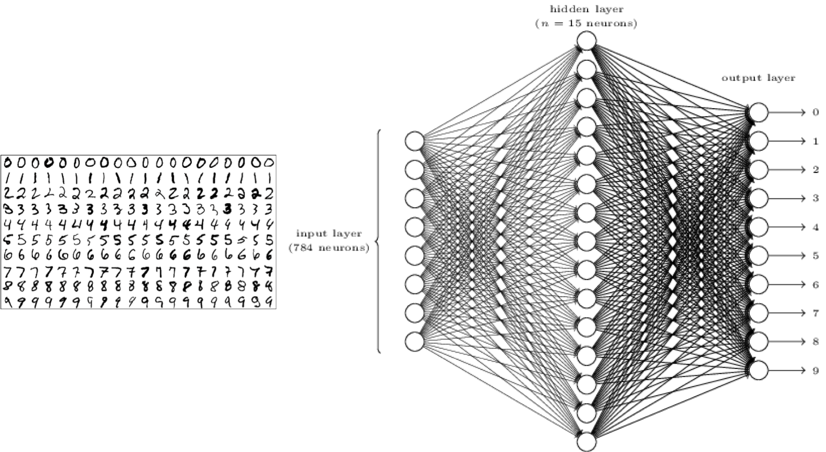
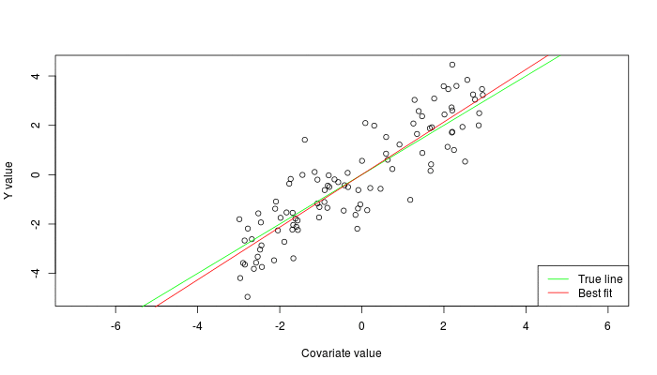
Supervised learning
classification
Regression

Slide 7
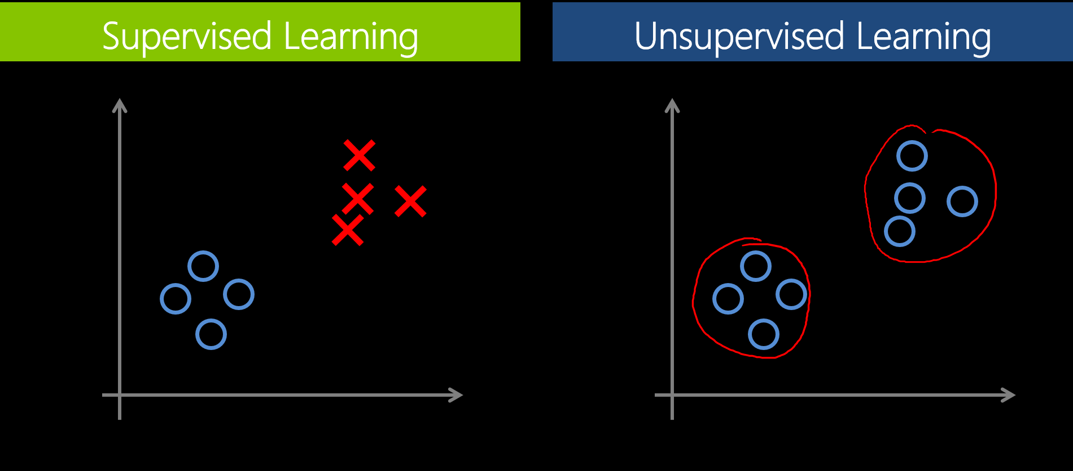
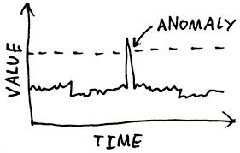
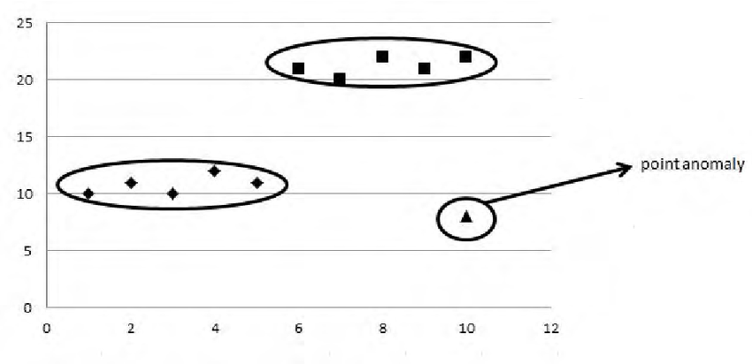
Unsupervised Learning
Data has no label
Clustering
Anomaly detection

Slide 8
More Regression
Statistics and Machine Learning Toolbox

Slide 9
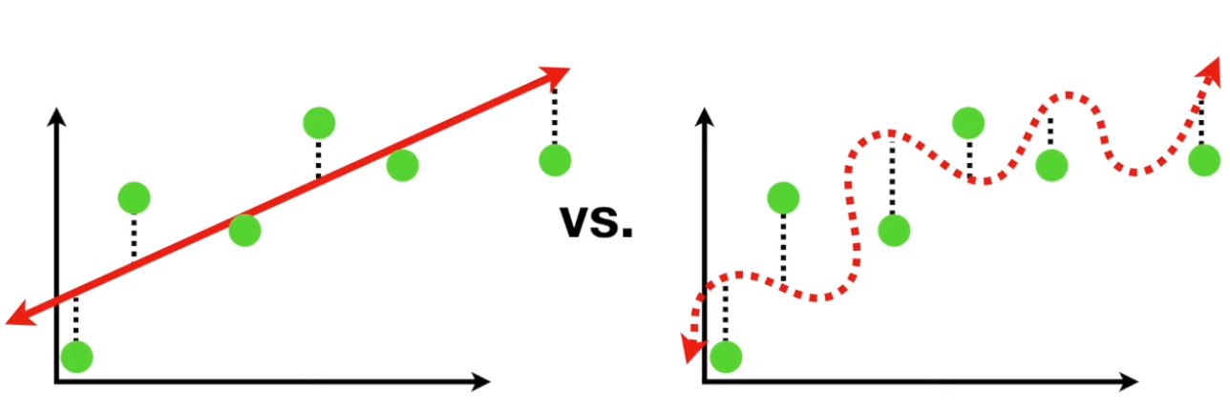
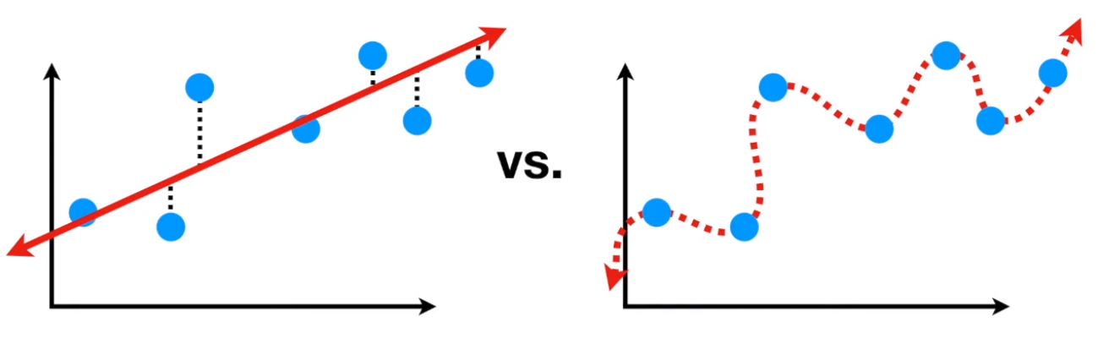
Overfitting
The bias variance tradeoff
More bias less variance
Less bias more variance

Slide 10
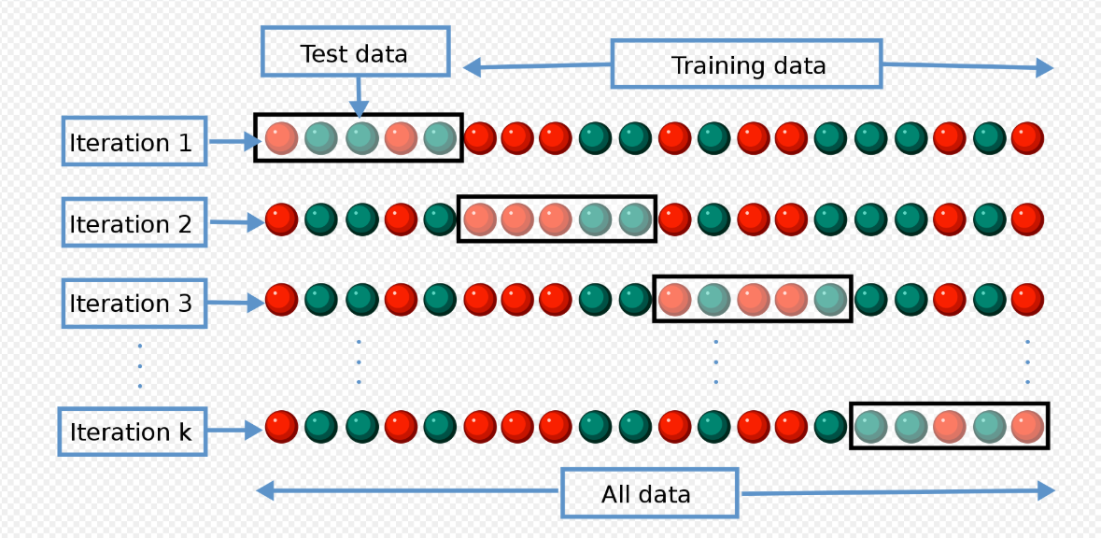
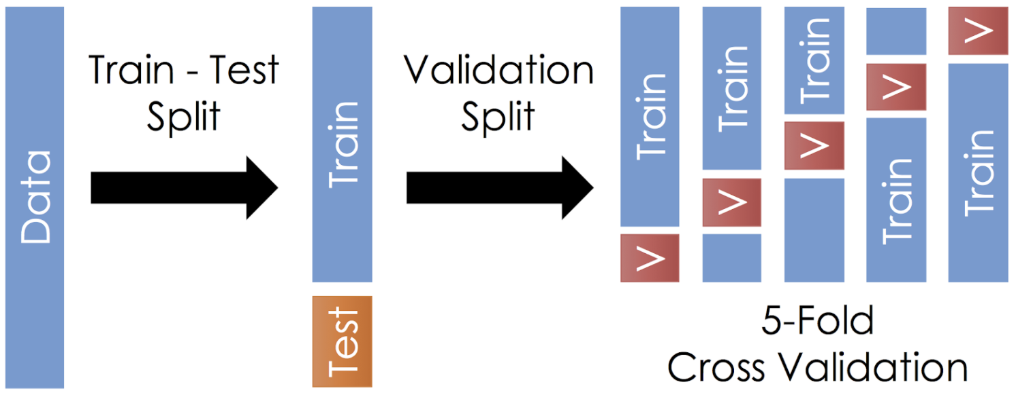
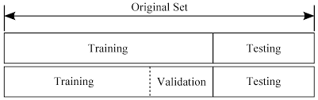
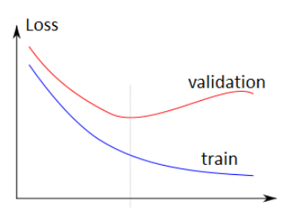
Train-(validation)-test split

Slide 11
Selecting models and tuning hyper parameters
Most ML model are just black boxes
More on this later
Most hyper parameters defines the complexity
adjust it to the complexity of you data (feature size)
adjust it to the size of you data (sample count)

Slide 12
Some regression models
Linear models
Simple, learned before
Very high bias so very low variance

Slide 13
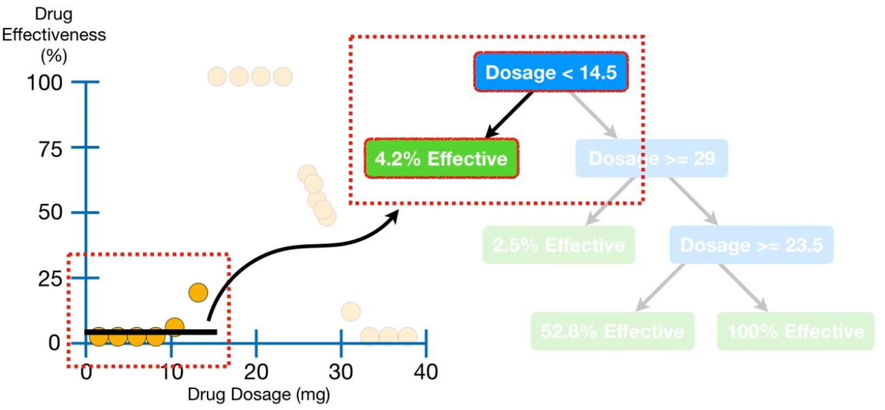
Some regression models
regression tree
Kind of decision tree
Can be very non-linear and can have very low bias
Can be seriously over fitting
Ensemble is a good way to avoid over fitting
Hypermeters:
The levels limit
The leaf nodes limit

Slide 14
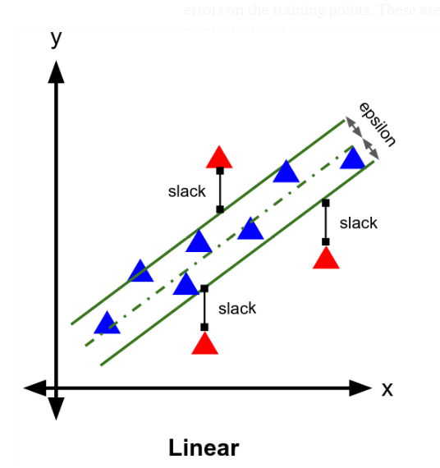
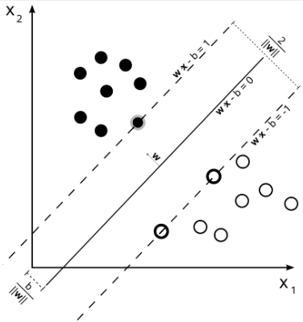
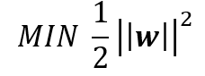
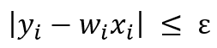
Some regression models
Support Vector Machine regression
To find the linear function
F (X)=WX+b,
The object is to mimimize:
The constrain is
The math is just like SVM classifier
Hyperperameter:
C
Kernals

Slide 15
Evaluate your models
Same as we learned before
Adjusted-r-square (over test set )
Response plot
Residual plot

Slide 16
# 数据科学入门2.2：简单的分类
## Introduction to Data Science Part2.2: Classification
Zheng Wei

Slide 17
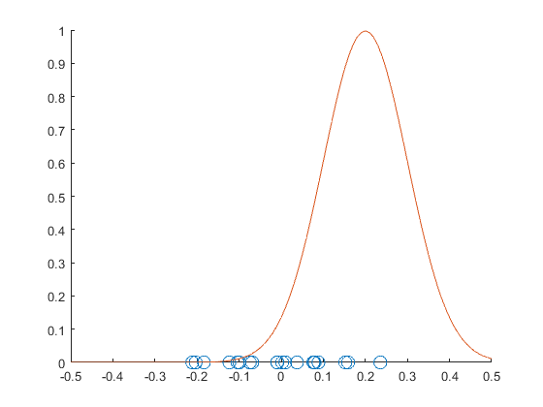
Classification
Classification is supervised learning
Maximum likelihood is used
Under the framework maximum likelihood, the error between two probability distributions is measured using cross-entropy.
P(y=class1|x)
y=class1 samples

Slide 18
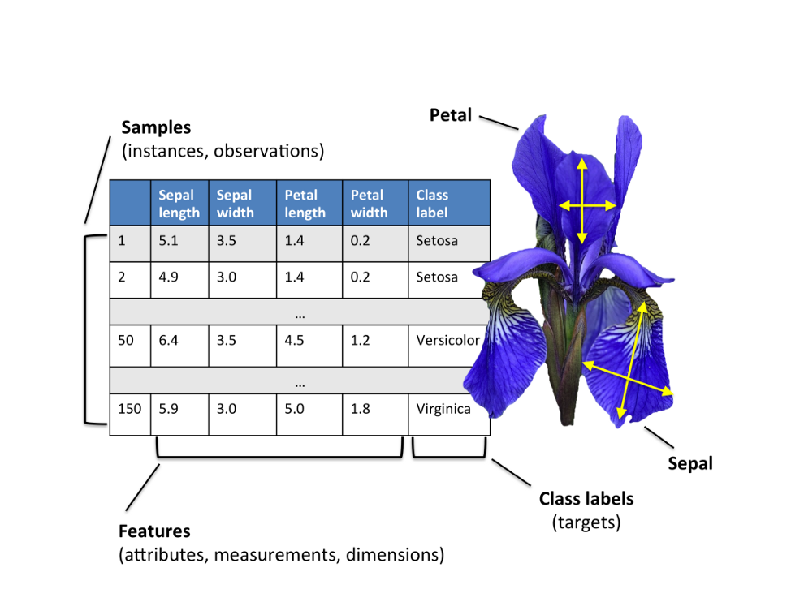

Iris classification

Slide 19
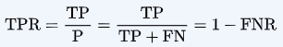
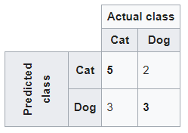
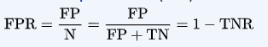
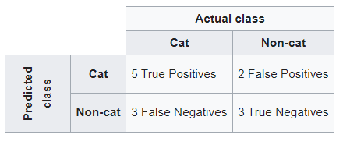
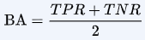
Evaluate a classification model
Confusion matrix
true positive (TP)
true negative (TN)
false positive (FP)
false negative (FN)
True positive rate (TPR) or sensitivity, recall, hit rate
False negative rate (FNR) or miss rate or
False positive rate (FPR) or fall-out or
True negative rate (TNR) or specificity, selectivity
balanced accuracy (BA)

Slide 20
# 数据科学入门2.3：分类模型得选择
## Introduction to Data Science Part2.3: Select classifiers
Zheng Wei

Slide 21
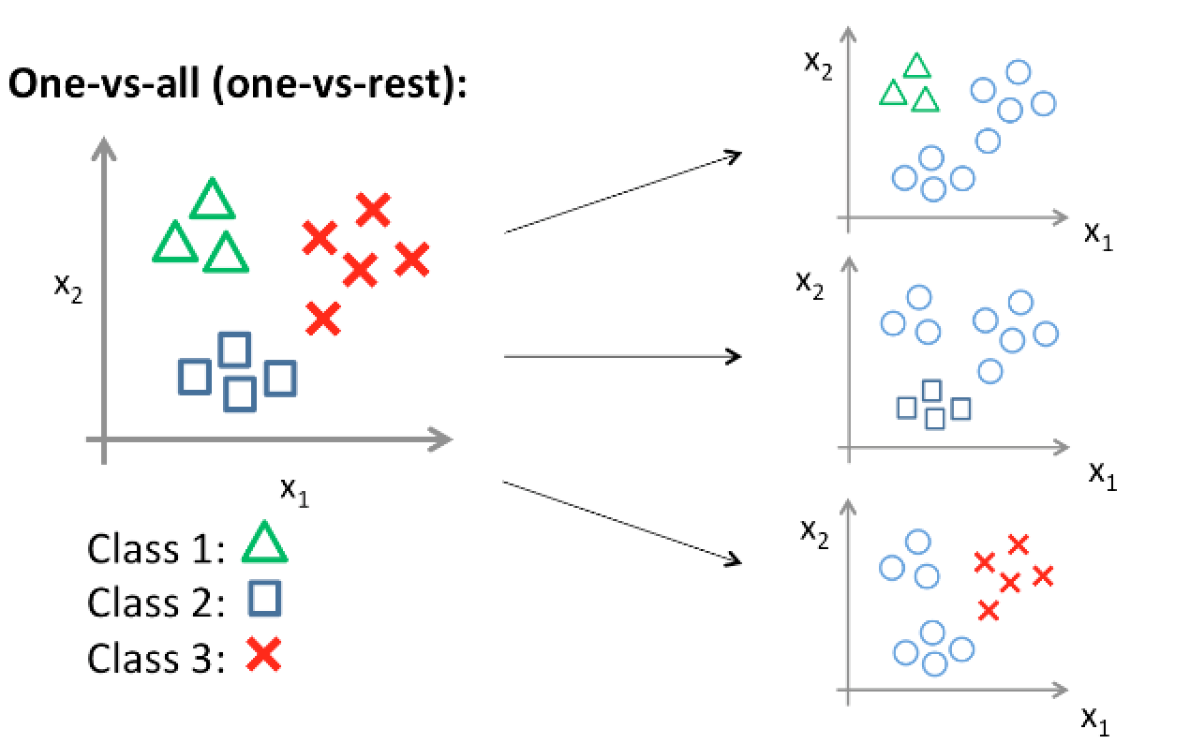
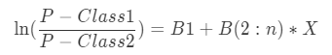
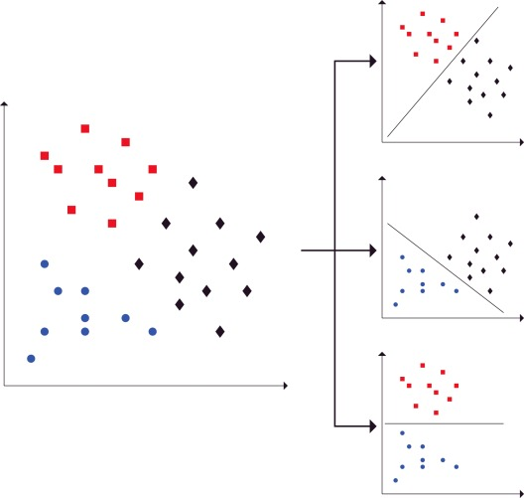
classifier的基本输出
Binary classifiers
Logistics regression
SVM， Y>0,Y<0
Binary classifiers as multi-class classifiers
one-vs-rest, need n classifiers
one-vs-one, need C(n,2) classifiers

Slide 22
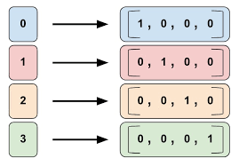
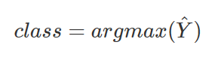
classifier的基本输出
One-hot encoding
argmax([0.1，0.05，0.8，0.05])=2

Slide 23
logistic regression
You already know it
Kinda like linear regression
High bias
Best for:
Simple data, low sample count, small feature size
Binary classification
Most features are continuous variable

Slide 24
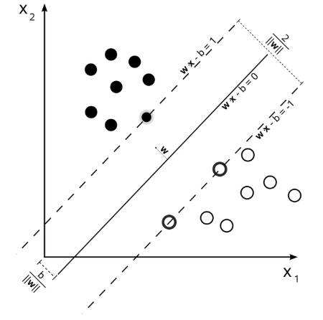
SVM，Support Vector Machine
Separate sample by maximum the margined
Achieved by Lagrangian optimization

Slide 25
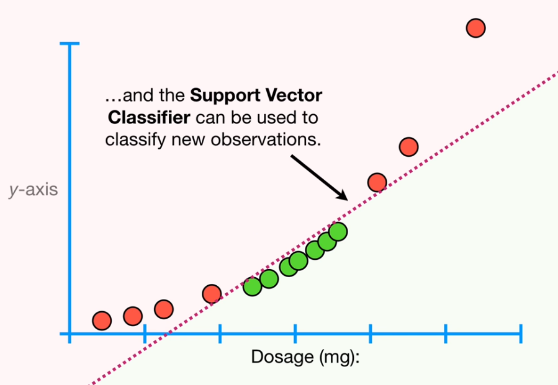
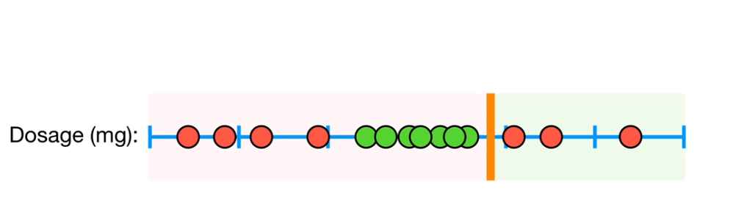
SVM，Support Vector Machine
Kernals
Hyper paramters
C
Kernals
Very flexible mode
Low bias
good for many types of data
Good if the feature size is large

Slide 26
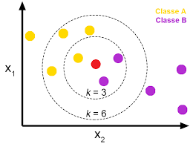
K-nearest neighbors
Count nearest neighbors
Larger count wins
Some variants use weighted vote upon distance
Hyper parameters
K
Distance calculation
High bias model
Best when sample size is large but feature size is small

Slide 27
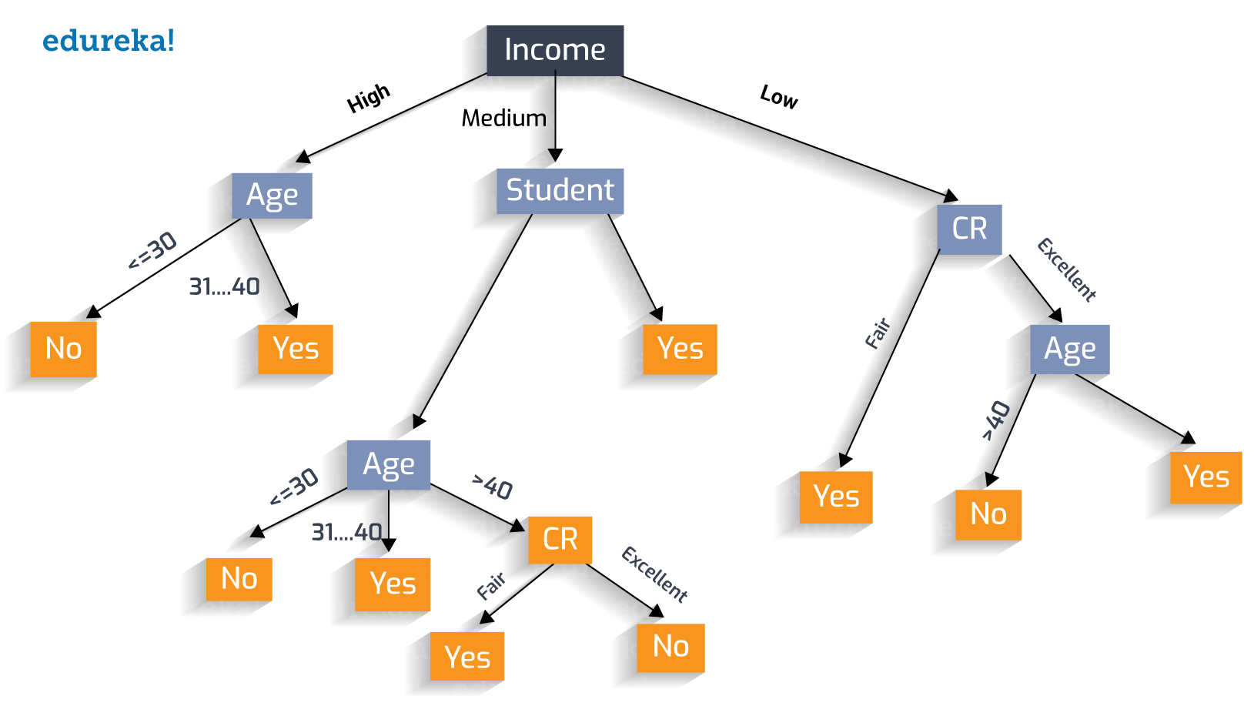
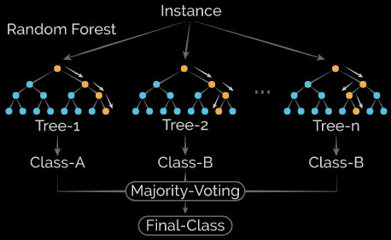
Decision Tree，ensemble of trees
Many variants
Basic trees tend to over fitting easily
Use ensemble
Hyper parameters
Criterion-mostly gini
Max depth
Max leaf nodes
min_samples_split

Slide 28
Model selection?
Just try many models and pick the overall best one

Slide 29
#数据科学入门2.4：特征的选取和特征提取
## Introduction to Data Science Part2.4: Simple Feature Engineering
Zheng Wei

Slide 30
Why
Less computational heavy, faster training
Less over fitting generalize better
Use our domain knowledge to create better features
Less noise better accuracy
Simpler model could be interpreted

Slide 31
Feature selection
Filter method

Slide 32
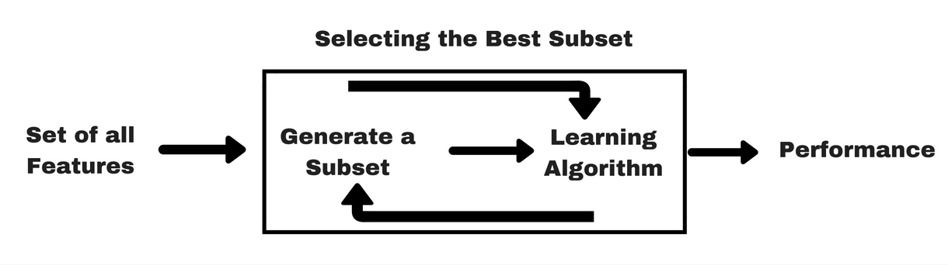
Wrapper methods

Slide 33
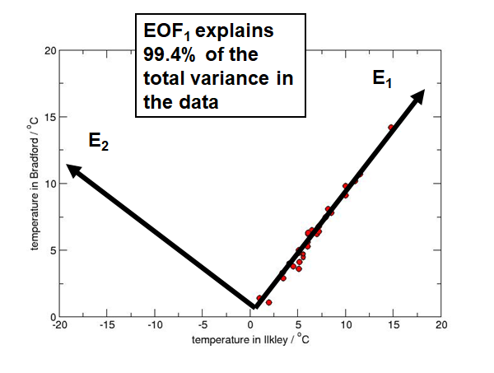
Feature extraction (feature creation)
PCA

Slide 34
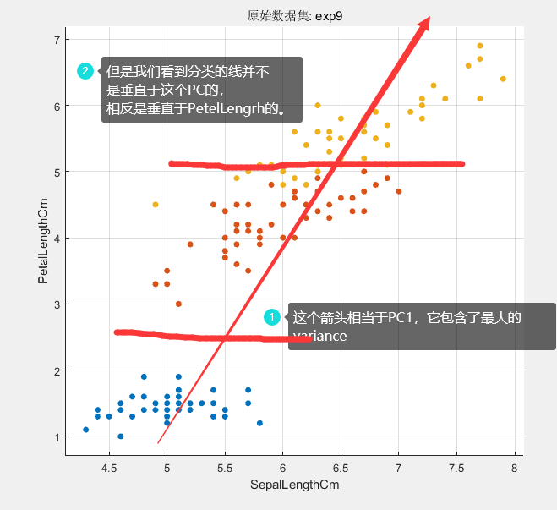

Slide 35
Feature extraction (feature creation)
Use your domain knowledge
More on this later

Slide 36
#数据科学入门2.5：简单得聚类
## Introduction to Data Science Part2.5: Simple Clustering
Zheng Wei

Slide 37
What is clustering
Clustering is unsupervised learning
Samples in their feature space, ones that are close to each other are cluster in to one cluster.

Slide 38
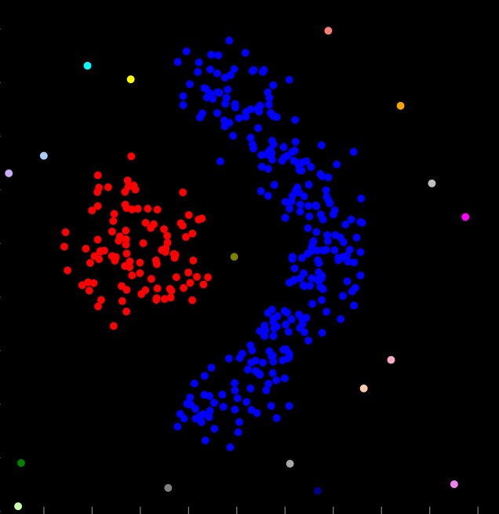
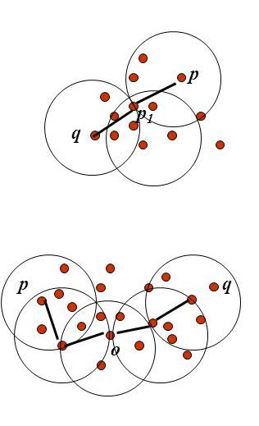
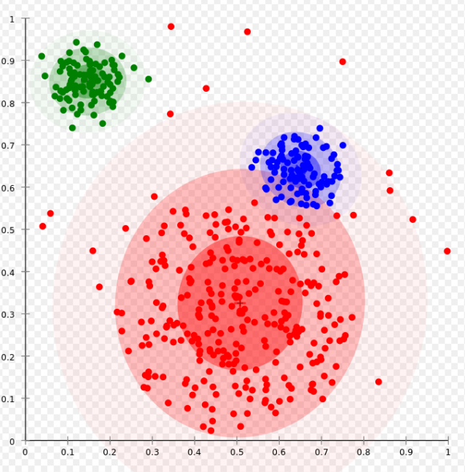
Types of clustering
1. Connectivity based
2. Density based
3. Distribution based
4. Centroid based

Slide 39
K-Means原理

Slide 40
K-Means原理
这个我一眼就看出来了
怎么让程序完成这个工作呢？

Slide 41
K-Means原理
第1步：确定要分为几类，K=？
我们分为3类，K=3

Slide 42
K-Means原理
第2步：随便选择3个类型的中心（重心）
我们就随便选3个点，让他们作为3个类型的中心
这3个点就分别属于对应的类型

Slide 43
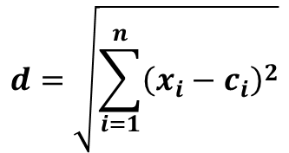
K-Means原理
第3步：计算第一个点到三个中心的距离
第4步：把第一个点分配个距离最近的类型
$$d=\sqrt{\sum_{i=1}^{n}{{\left(x_{i}−c_{i}\right)}^{2}}}$$

Slide 44
K-Means原理
第5步：对剩下的点做3，4步

Slide 45
K-Means原理
第6步：重新计算每个几个的中心（Mean）
第7步：3-6步，直到每个点所属的类型不在变化为止

Slide 46
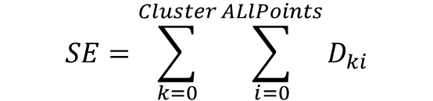
K-Means原理
分好了！但是结果好像不太好 ☹
怎么评价我们的结果好坏？
$$SE=\sum_{k=0}^{Cluster}{\sum_{i=0}^{ALlPoints}{D_{ki}}}$$

Slide 47
K-Means原理
重新开始，第1步，K=3
第2步：随便选择3个类型的中心（重心）
我们就随便选3个点，让他们作为3个类型的中心
这3个点就分别属于对应的类型

Slide 48
K-Means原理
第3步：计算第一个点到三个中心的距离
第4步：把第一个点分配个距离最近的类型

Slide 49
K-Means原理
第5步：对剩下的点做3，4步

Slide 50
K-Means原理
第6步：重新计算每个几个的中心（Mean）
第7步：3-6步，直到每个点所属的类型不在变化为止

Slide 51
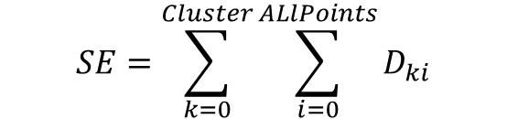
K-Means原理
第6步：重新计算每个几个的中心（Mean）
第7步：3-6步，直到每个点所属的类型不在变化为止
$$SE=\sum_{k=0}^{Cluster}{\sum_{i=0}^{ALlPoints}{D_{ki}}}$$
电脑并不知道这个是最好的结果，于是他再重复以上步骤多次，选取最好的结果

Slide 52
K-Means原理——2维数据

Slide 53
K-Means原理——2维数据
第1步：确定要分为几类，K=？
第2步：随便选择K个类型的中心

Slide 54
K-Means原理——2维数据
第3步：计算每个点到三个中心的距离
第4步：把第一个点分配个距离最近的类型

Slide 55
K-Means原理——2维数据
第6步：重新计算每个类型的中心

Slide 56
K-Means原理——2维数据
第7步：3-6步，直到每个点所属的类型不在变化为止
(第3步：计算每个点到三个中心的距离
第4步：把第一个点分配个距离最近的类型
第5步：对剩下的点做3，4步)

Slide 57
K-Means原理——2维数据
第7步：3-6步，直到每个点所属的类型不在变化为止
(第6步：重新计算每个类型的中心)

Slide 58
K-Means原理——2维数据
第7步：3-6步，直到每个点所属的类型不在变化为止
(第3步：计算每个点到三个中心的距离
第4步：把第一个点分配个距离最近的类型
第5步：对剩下的点做3，4步)

Slide 59
K-Means原理——2维数据
第7步：3-6步，直到每个点所属的类型不在变化为止
(第6步：重新计算每个类型的中心)

Slide 60
K-Means原理——2维数据

Slide 61
K-Means原理——2维数据
每个点所属的类没有变化, 完成!

Slide 62
K-Means原理
问题：那怎么确定K呢？
方法一：你希望分成几类就让K=几。
大人，小孩，
男生，女生
好，中，差

Slide 63
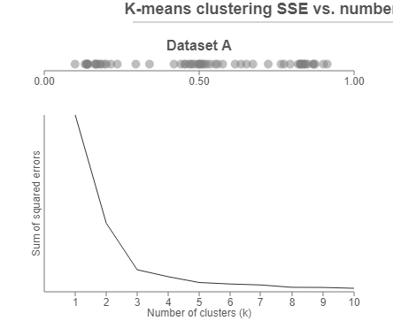
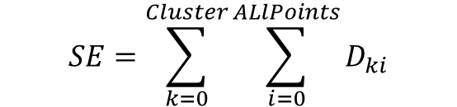
K-Means原理
Elbow Method
K=1
K=2
K=n
K=3
$$SE=\sum_{k=0}^{Cluster}{\sum_{i=0}^{ALlPoints}{D_{ki}}}$$

Slide 64
#数据科学入门2.5.9：人工神经网络入门
## Introduction to Data Science Part2.5.9: Demystify the artificial neural network
Zheng Wei

Slide 65
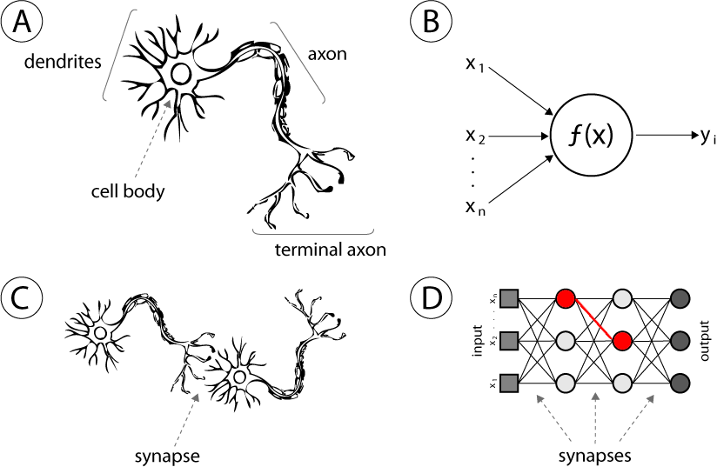
Artificial neural network
树突
树突
轴突
轴突
细胞体
突触
突触

Slide 66









How it works
$$o=σ(\sum_{i=1}^{n}{x_{i}∗w_{ij}}+b)$$
$$σ$$
$$o=σ(WX+b)$$
b
Bias
W₁ [4*3]
X [3*1]
B₁ [4*1]
H [4*1]
$$H=σ(W_{1}X+B_{1})$$
W₁
W₂
$$Y=σ(W_{2}H+B_{2})$$
W₂ [2*4]
H [4*1]
B₂ [2*1]
Y [2*1]
Y
X
H
$$\hat{Y}=f(X,W,B)$$
4+2=6个神经元 3*4+4*2=20个weight，4+2=6个bias，26个可优化参数

Slide 67










How it is trained?
Inference，预测
0.2
0.2
0.2
0.2
1
$\hat{Y}=$0.12
X1
0.2
0.2
0.2
0.2
$Y=$1
0
0.2
0.2
X2
0.2
$$l=\frac{1}{n}\sum_{i=1}^{n}{{(Y_{i}−{\hat{Y}}_{i})}^{2}}$$
0.2
Loss Function
Train，训练
$$Min(l)$$
X1 | X2 | Y
1 | 0 | 1
0 | 1 | 1
1 | 1 | 0
0 | 0 | 0
$θ=$ $[w_{1},w_{2},,b_{1},b_{2},,,]$
$$Y=X_{1}⨁X_{2}$$
$$∇_{θ}l\left(θ\right)=[\frac{∂l}{w_{1}},\frac{∂l}{w_{2}},,,,,\frac{∂l}{b_{1}},\frac{∂l}{b_{2}},,,,,]$$

Slide 68
Matlab sallow neural network
Simple regression
Time series
Just for fun, not serious application

Slide 69
#数据科学入门2.6：一点点深度学习
## Introduction to Data Science Part2.6: a glance of deep learning
Zheng Wei

Slide 70
Before we start
Why we want deep learning
First we look a traditional learning on complex data

Slide 71


Why deep learning (below is only partly true)
Remember the feature engineering we did in previous class?
When it’s hard to extract meaningful low dimension features.
When there are lots of features
When there are lots of samples

Slide 72
Assignment
Redo the examples in this class
Try Titanic survival data using models and evaluation methods learned in this class

Slide 73


If you want to know more

